Slide 1


Laptop Market Sales Analysis Using Web Scraping ( Amazon )

Slide 2
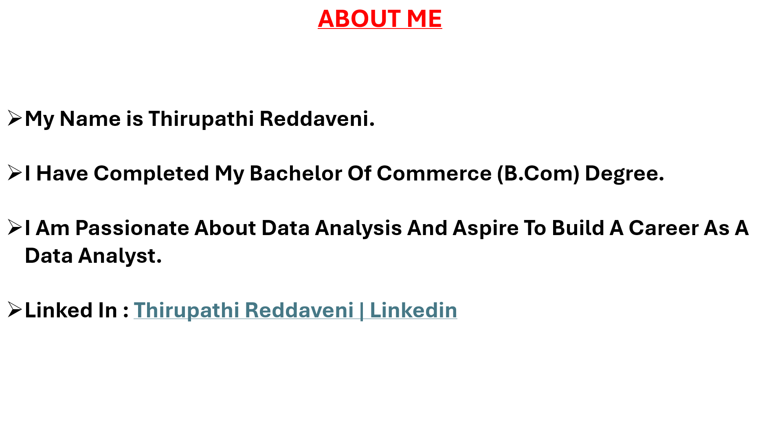


Slide 3
Agenda
Business Problem And Objective
Web Scraping Details
Summary Of The Data
Data Cleaning Process
Univariate Analysis
BI Variate Analysis
Multi Variate Analysis
Hypothesis Test
Challenges
Recommendations
Conclusion

Slide 4
Business Problem And Domain
“Laptop Pricing Varies Widely In The Market, And It Is Unclear Which Product Features Significantly Influence The Final Price.”
“Customers Face Difficulty Comparing Laptops Due To Wide Variations In Specifications, Brands, And Prices Across The Market.”
Objective Of The Project
“To Analyze Laptop Specifications Such As Brand, Processor, RAM, Storage, And Ratings To Understand Their Impact On Laptop Pricing.”
“ Understand Laptop Market Trends From Scraped Amazon Data .”

Slide 5
Web Scraping Details
Website : Amazon.com. Spend less. Smile more.
Tools Used: Selenium, Python, Locators, and Regular Expressions (Regex)
Approach : Inspecting The Website > Install Selenium > Opens Target URL > Locate Elements > Extract The Data Using Regex > Clean The Data > Store The Data.
Saved To Structured Data Frame For EDA Analysis.

Slide 6
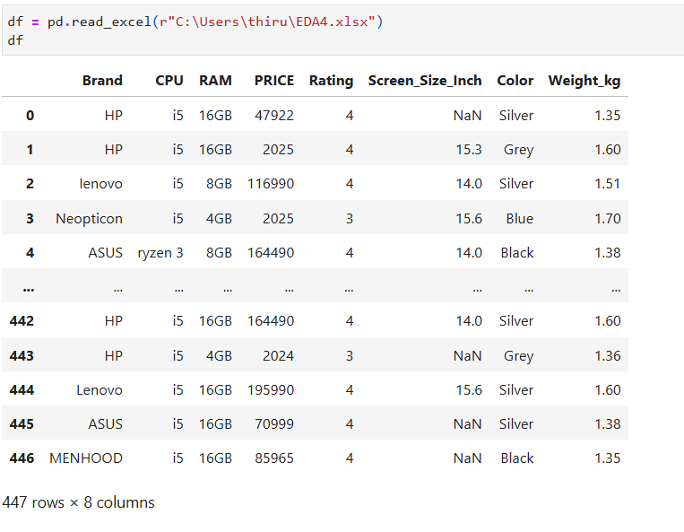
Summary Of The Data
447 Variants Extracted.
8 Colums : Brand,CPU, RAM, Price, Rating, Screen_Inch, Color And Weight_kg.

Slide 7
Data Cleaning
Handled Missing Values.
Merging Multiple Datasets Into One.
Manually Checked Variant Rows Missing Like Ratings, RAM And Color.
Renaming The Columns Old To New.
Removed Unwanted Text And Units, Price And Weight_kg To Numerical Types.
This Cleaning Process Improved Dataset Completeness And Formatting, Enabling Accurate Analysis And Visualization.

Slide 8
Univariate Analysis
Applied Univariate Analysis On These Columns :
Price
Brand
CPU
Screen_size_Inch

Slide 9
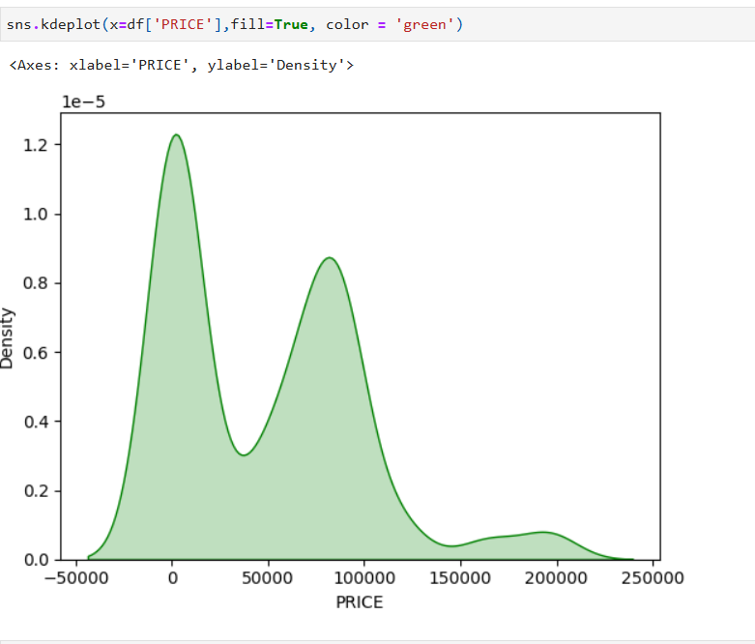
Price Distribution :
Right Skewed Distribution
X-axis (Price): Shows The Distribution Of Product Prices Across Different Price Ranges.
Y-axis (Density): Indicates How Densely Prices Are Concentrated At Each Level, Not The Number Of Products
Peaks In The Curve: Represent Price Ranges Where Products Are Most Common (Market Segments).

Slide 10
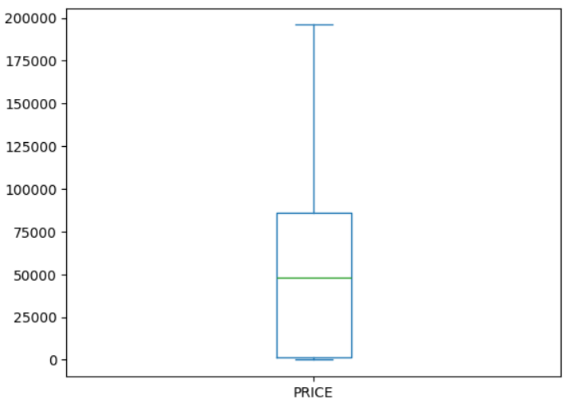
Box Plot Of Prices :
The Median Price Lies Around The Mid-range, Indicating A Typical Product Cost Near The Center Of The Data.
The Upper Whisker Is Much Longer Than The Lower One, Showing A Right-skewed Distribution.
The Presence Of Very High Values Indicates Premium Or Outlier Products.

Slide 11
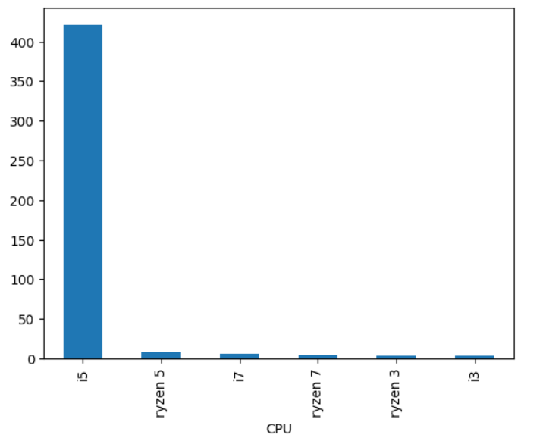
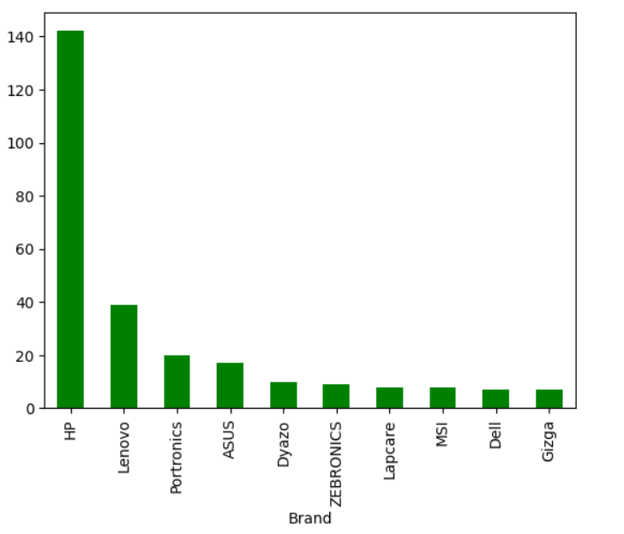
Types Of CPU :
Brand Variants :
Interpretation :
CPU Distribution: The market is heavily concentrated around Intel i5, highlighting a clear preference for balanced performance and affordability, while high-end CPUs show limited demand.
Interpretation :
Brand Presence: HP dominates the brand landscape, with significantly higher model availability, indicating strong consumer trust and market leadership.

Slide 12
BI Variate Analysis
Comparisons :
RAM And Price.
Screen_size_inch And Price.
Rating And Price.
Rating And Color.
Correlation :
Price And Rating.

Slide 13
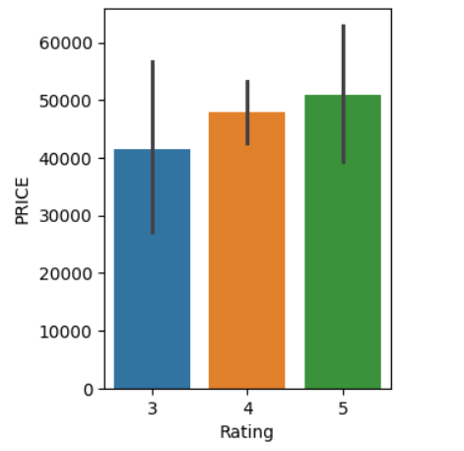
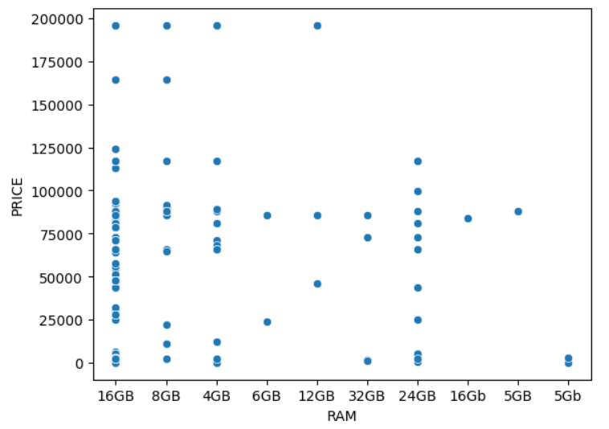
RAM And Price :
Rating and Price :
Interpretation :
Interpretation :
X-axis (RAM): Shows Different RAM Configurations (4GB, 8GB, 16GB, Etc.).
Y-axis (Price): Represents The Product Price According to Each Ram Size.
Insight: Higher Ram Generally Trends Toward Higher Prices, But The Wide Spread Shows Price Is Also Influenced By Other Factors (Brand, Processor, Features).
X-axis (Rating): Represents Customer Ratings (3, 4, And 5 Stars).
Y-axis (Price): Shows The Average Price Of Products For Each Rating Level.
Insight: Products With Higher Ratings Tend To Have Higher Average Prices, Indicating A Positive Relationship Between Quality Perception And Price.

Slide 14
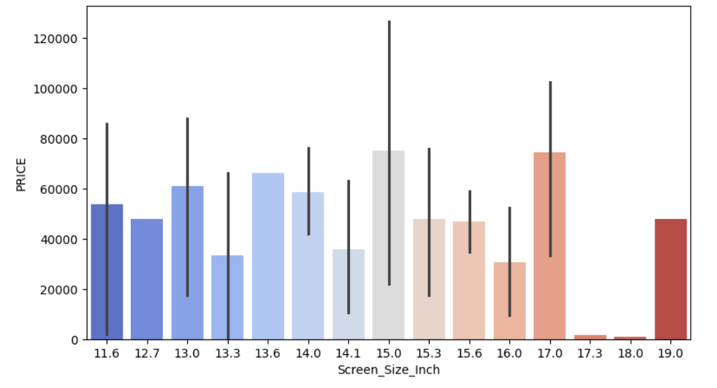
Screen_Size_Inch And Price :
Interpretation :
Laptop Prices Generally Increase With Larger Screen Sizes, With 15–17 Inch Models Showing The Highest Average Prices.
Wide Error Bars Across Most Screen Sizes Indicate High Price Variability, Meaning Screen Size Alone Does Not Determine Pricing.

Slide 15
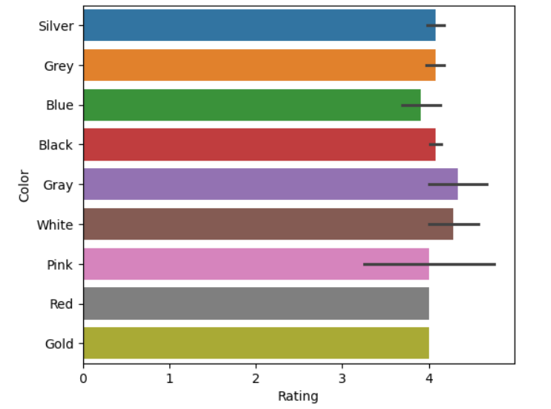
Rating And Color :
Interpretation :
Average Ratings Are Similar Across All Colors, Clustered Around ~4, Indicating Color Has Minimal Impact On Customer Satisfaction.
Minor Variations (E.G., Gray And White Slightly Higher) Are Not Significant Enough To Drive Purchasing Decisions.
Most Of The People Avoiding Blue Color to Purchase.

Slide 16
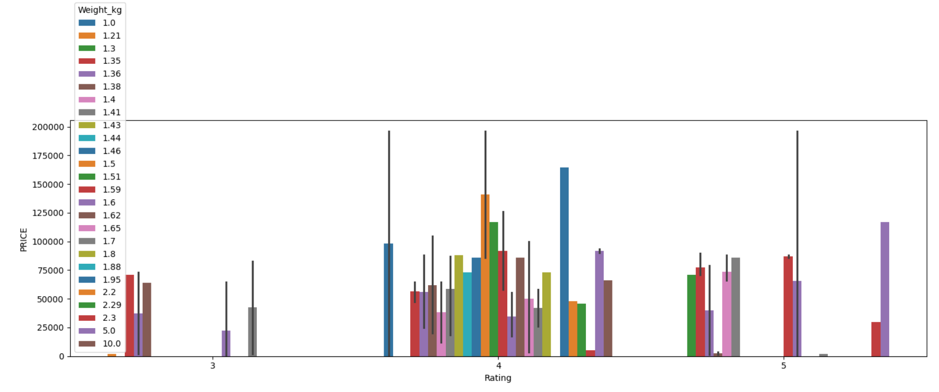
Multi Variate Analysis
Rating, Price and Weight_Kg :
Interpretation :
Higher-rated Laptops Tend To Be Priced Higher, But Wide Variation Across Weights Shows That Price Is Influenced By Multiple Factors, Not Rating Alone.
Weight Does Not Show A Clear Impact On Price—laptops With Similar Ratings But Different Weights Are Priced Very Differently, Indicating Other Factors Dominate Pricing.

Slide 17
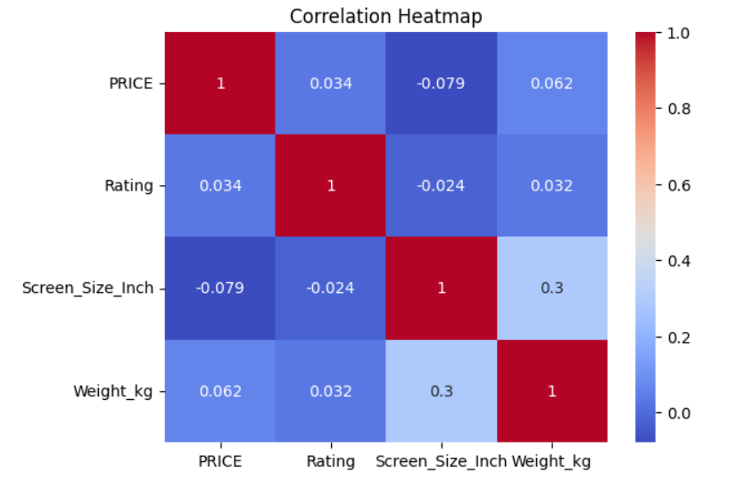
Correalation Heat Map : Price, Rating, Screen_Size and Weight_Kg.
Interpretation :
PRICE vs other features: Price shows very weak correlation with rating, screen size, and weight, indicating price depends on multiple combined factors.
Screen Size vs Weight: There is a moderate positive correlation (~0.3), meaning larger screens generally result in heavier laptops.
Overall insight: No single feature strongly drives price on its own; pricing is multifactor-driven, not feature-dependent.

Slide 18
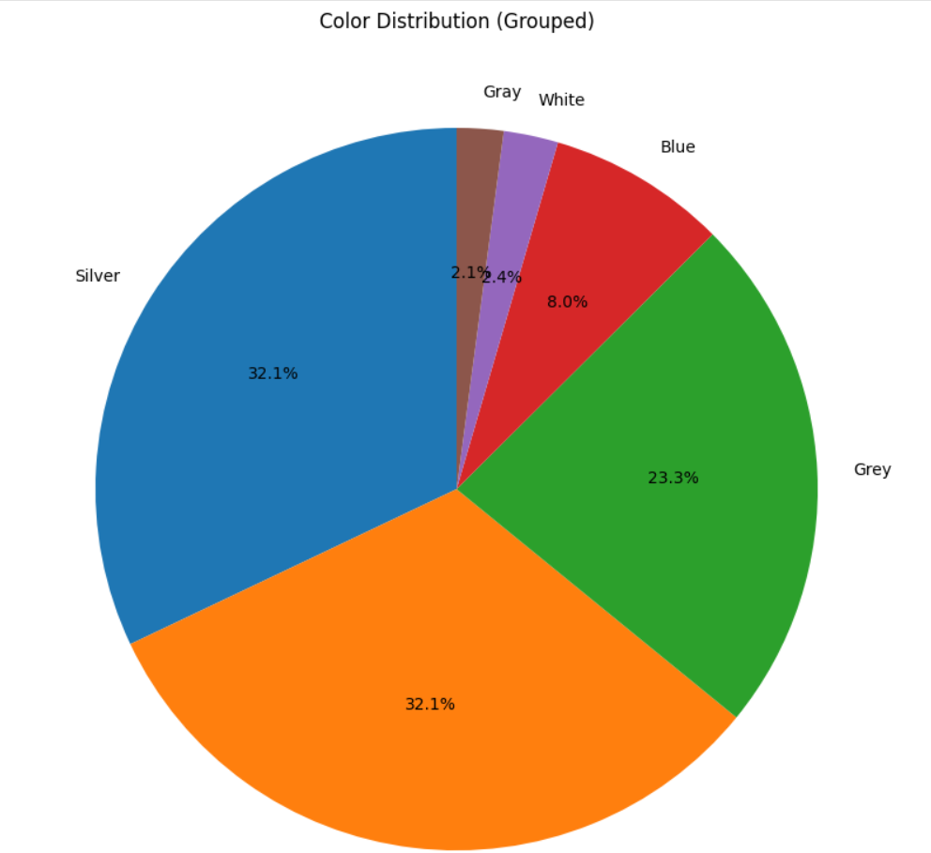



Color Distribution Across All Data :
Blue
Gold
White
Silver
Gray
Black
Interpretation :
Silver And Black Dominate The Market, Together Accounting For The Largest Share, Showing Strong Consumer Preference For Neutral, Premium-looking Colors.
Colors Like Gold, Blue, White, Have Much Smaller Shares, Indicating Limited Impact Of Color Variation On Purchasing Decisions.

Slide 19
WHY Hypothesis Comes After Visualization?
Because Visuals Tell Us What Looks True.
Statistics Tell Us Whether It Is Actually True.
Hypothesis 1 Between RAM vs Price
H0: RAM Has No Impact On Price
H1: Higher RAM Increases Price
ANOVA p-value: 0.00014083307984405757
if p_value < 0.05:
print("Reject H₀ → RAM significantly affects price")
else:
print("Fail to reject H₀ → No significant impact") →Yes RAM Increases Price.
Output :
Reject H₀ → RAM significantly affects price

Slide 20
Hypothesis 2 Between Rating vs Price
H0: Rating Has No Impact On Price
H1: Higher Rating Increases Price
p_value : 0.7521529065902437
if p_stats < 0.05:
print("Reject H₀ → Rating significantly affects price")
else:
print("Fail to reject H₀ → No significant impact") → H0 is Correct, Customer Rating Doesn’t Increase Price
Output :
Fail to reject H₀ → No significant impact

Slide 21
Hypothesis 3 Between CPU And Price
H0: CPU has no impact on price
H1: Higher CPU increases price
p_value : 7.4106565502904215e-06
p_value = 7.4106565502904215e-06
7.41 × 10⁻⁶ = 0.00000741
p-value = 0.00000741 < 0.05
if p_stats < 0.05:
print("Reject H₀ → CPU significantly affects price")
else:
print("Fail to reject H₀ → No significant impact") → Yes Higher CPU Increases Price.
Output :
Reject H₀ → CPU significantly affects price

Slide 22
Challenges
Handling Missing / Null Values Efficiently Using Pandas (Fillna, Dropna) Without Losing Key Data.
Categorical Inconsistency In Brand, Processor And Names Requiring Preprocessing.
Outliers From Gaming And Premium Laptops, Impacting Summary Statistics.
Limited Numerical Sales Metrics, Restricting Predictive And Trend Analysis.
Visualizing Complex Relationships Between Features Using Seaborn (Heatmap) For Clarity.

Slide 23
Recommendations
Focus On Mid-range Laptops As They Drive The Highest Market Demand And Sales Volume.
Prioritize Performance Upgrades (RAM, CPU) Over Cosmetic Features To Attract Buyers.
Offer Competitive Pricing For Popular Configurations (Intel I5, 8–16 Gb Ram).
Strengthen Brand Positioning And Trust, As Brand Perception Influences Pricing Decisions.
Use Customer Ratings For Quality Improvement, Not As A Primary Pricing Factor.
Use Ratings And Reviews To Improve Product Quality And After-sales Service, Not Just Promotions.

Slide 24
Conclusion
RAM And CPU Are The Strongest Factors Influencing Laptop Prices.
Intel I5 Processors Dominate The Market, Showing Highest Customer Demand.
Most Laptops Fall In The Mid-price Range ( Upto 50,000 ), Indicating Preference For Value-for-money Models.
Brand Reputation Impacts Pricing, Even With Similar Specifications.
Customer Ratings Have Weak Influence On Price, Reflecting Satisfaction Rather Than Cost.
Price Distribution Is Right-skewed, With Fewer High-end Premium Laptops.

Slide 25


